Slide 1
Model Checking with SPIN
A Bit More about SPIN
Wishnu Prasetya
wishnu@cs.uu.nl
www.cs.uu.nl/docs/vakken/pv

Slide 2
Content
SPIN internal data structures
SPIN result report
Writing LTL formulas
Containing state explosion
Example
Acknowledgement: some slides are taken and adapted from Theo Ruys’s SPIN Tutorials.

Slide 3
Data structures involved in SPIN DFS
Representation of a state.
Stack for the DFS
  To remember where to backtrack in DFS
  It corresponds to the current “execution prefix” that is being inspected → used for reporting.
Something to hold the set of visited states = “state space”.

Slide 4
State
Each (global) state of a system is a “product” of the states of its processes.
E.g. Suppose we have:
  One global var byte x
  Process P with byte y
  Process Q with byte z
Each system state should describe:
  all these variables
  Program counter of each process
  Other SPIN predefined vars
Represent each global state as a tuple … this tuple can be quite big.

Slide 5
The stack, optimization
To save space SPIN does not keep a stack of states (large), but rather a stack of action-IDs (smaller)
But, when you backtrack you need to know the state!
SPIN pre-calculated the reverse/undo of every action. So, knowing the current state is sufficient.

Slide 6
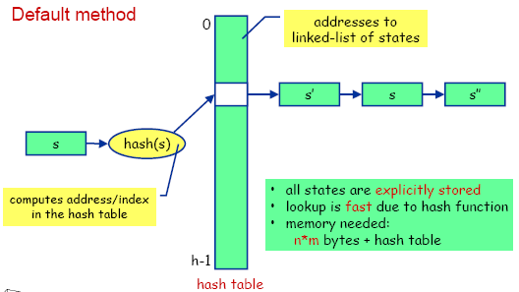
State-space is stored with a hash table
The list of “visited states” is maintained by a Hash-table. So matching if a state occurring in the table is fast!
Optimization: bit state hashing ☺

Slide 7
Verifier’s output
assertion violated !((crit[0]&&crit[1])) (at depth 5) // computation depth
...
Warning: Search not completed
Full statespace search for:
...
never-claim - (not selected)
assertion violations +
invalid endstates +
State-vector 20 byte, depth reached 7, errors: 1 // max. stack depth
24 states, stored // states stored in hash table
17 states, matched // states found re-revisited
41 transitions (= stored+matched)
hash conflicts: 0 (resolved)
(max size 2^19 states)
2.542 memory usage (Mbyte)

Slide 8

Specifying LTL properties
(Check out the Manual)
SPIN then generates the Buchi automaton for this LTL formula; called “Never Claim” in SPIN.
#define PinCritical crit[1]
#define QinCritical crit[2]
[]!(PinCritical && QinCritical)

Slide 9
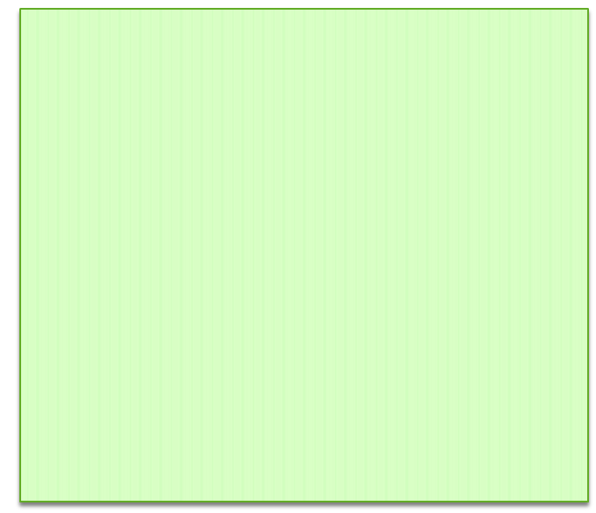
Example of a Never Claim
To verify: <>[] p
SPIN generates this never-claim / Buchi of []<>¬p
never {
init:
if
:: ¬p → goto accept
:: else → goto init
fi;
accept:
skip; goto init ;
}

Slide 10
Neverclaim
From SPIN perspective, a neverclaim is just another process, but it is executed in “lock-step” :
  innitially, it is executed first, before the system does it first step
  then, after each step of the system, we execute a step from the neverclaim.
Is used to express properties
  E.g. by writing assertions inside a neverclaim
  Or by using acceptance states

Slide 11
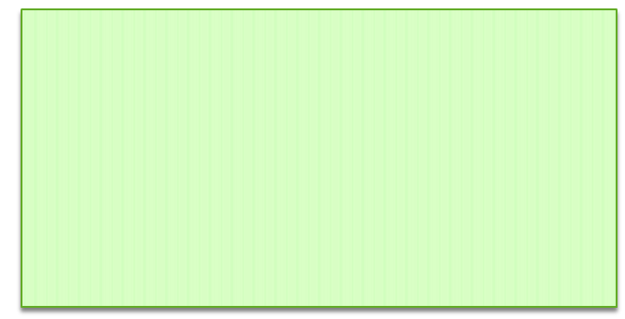
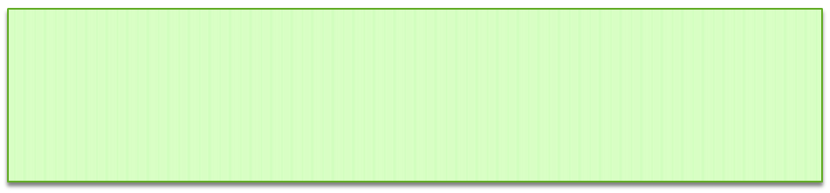
You can also manually write your custom NC …
never {
do
:: assert (b) ; assert (!b)
od
}
Expressing the value of b should be alternating.
never {
accept : do :: (x==0) ; (x==1) od
}
recognize an execution where (x==0)(x==1) holds alternatingly, which would then be considered as error.

Slide 12
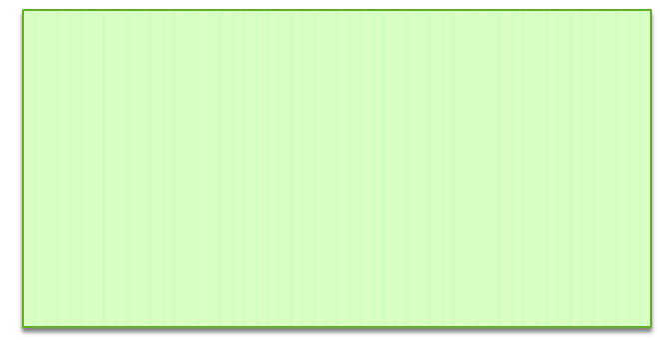
Watch out for state explosion!
int x,y,z ;
P { do :: x++ od }
Q { do :: y++ od }
R { do :: x/=y → z++ od }
Size of each state: > 12 bytes
Number of possible states ≈ (2³²) ³ = 2⁹⁶
Using byte (instead of int) brings this down to 50 MB
Focus on the critical aspect of your model; abstract from data when possible.

Slide 13
Imposing a coarser grain atomicity
atomic { guard → stmt_1; ... ; stmt_n }
active proctype P { x++ ; (y>0) ; y-- ; x=y }
put in atomic ?
more abstract, less error prone, but less parallelism
executable if the guard statement is executable
none of stmt-i should be blocking; or rather : if any of then blocks, atomicity is lost

Slide 14
d_step sequences
d_step { guard → stmt_1; ... ; stmt_n }
d_step { /* reset array elements to 0 */
i = 0;
do
:: i < N -> x[i] = 0; i++
:: else -> break
od;
i = 0
}
like an atomic, but must be deterministic and may not block anywhere
atomic and d_step sequences are often used as a model reduction method, to lower complexity of large models (improving tractability)

Slide 15
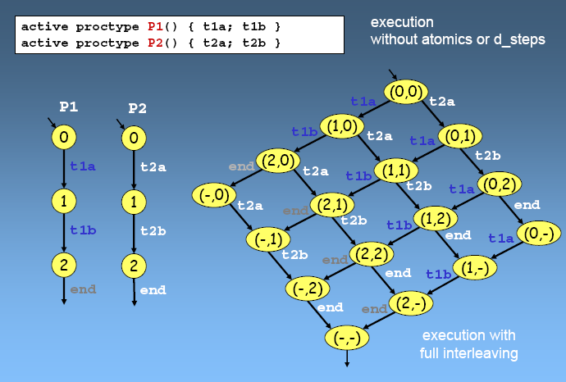
execution without atomics or d_steps

Slide 16
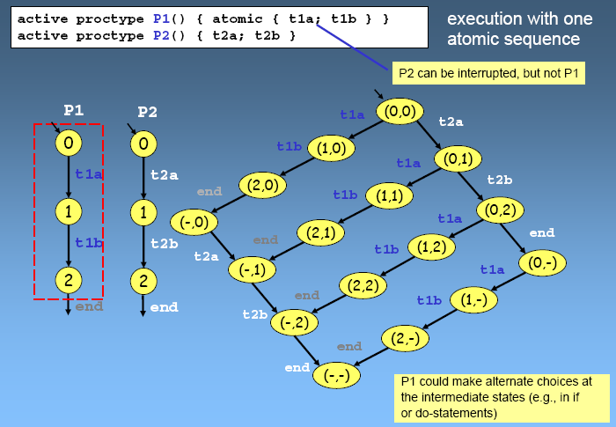
execution with one atomic sequence

Slide 17
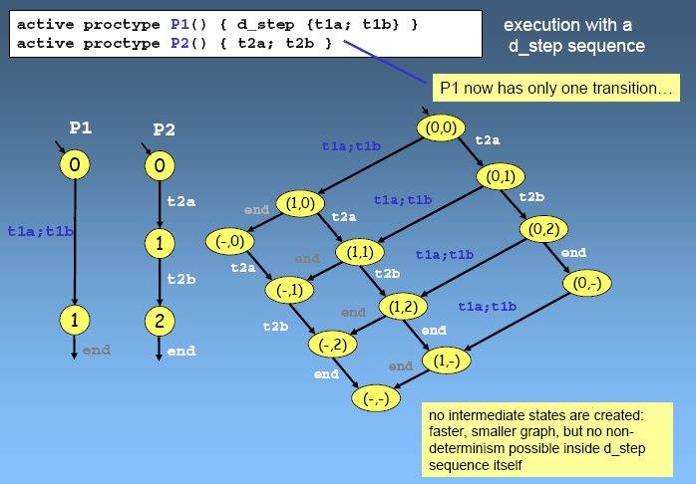
execution with a d_step sequence

Slide 18
atomic vs d_step
d_step:
  translated to a single piece of C code
  executed as one block
  therefore is deterministic
  blocking or non-termination would hang you ☺
  no way verifier can peek into intermediate states
atomic:
  translated to a series of actions
  executed step-by-step, but without interleaving
  it can make non-deterministic choices
  verifies sees intermediate states

Slide 19
Partial Order Reduction
The validity of a property ϕ is often insensitive to the order in which ‘independent’ actions are interleaved.
e.g. stutter invariant ϕ (does not contain X) that only refers to global variables, is insensitive to the relative order of actions that only access local variables.
Idea: if in some global state, a process P can execute only actions updating local variables, always do these actions first (so they will not be interleaved!)
We can also do the same with actions that :
  receive from a queue, from which no other process receives
  send to a queue, to which no other process sends
Notes:
Example:
var x=10
process P var y=0 do: y++ ; y++ ; x=y
process Q x--
Note: PO with channel actions → only when the spec does not refer to the channel contents! Note that c!e and c?x will then not interfere with each other; so PO is safe.

Slide 20
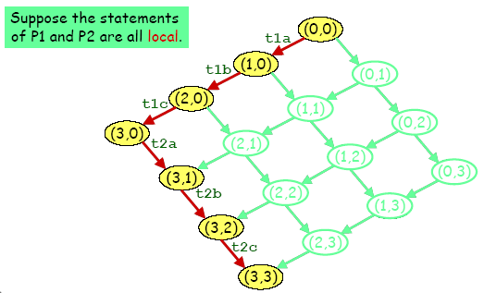
Reduction Algorithms
Partial Order Reduction

Slide 21
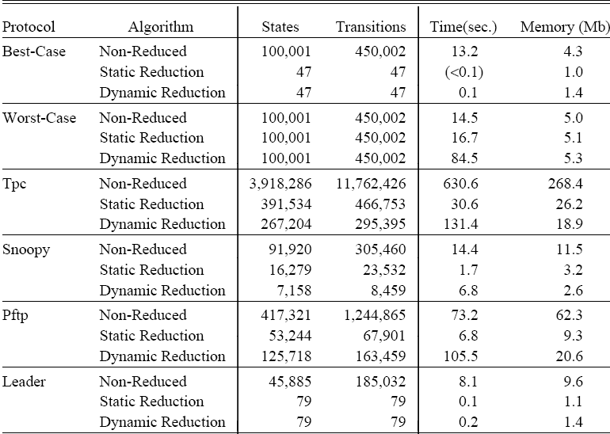
Results on Partial Order Reduction
This result is from Holzmann & Peled in 1994, on a Sparc-10 workstation with 128Mbyte of RAM. (about 40 mhz; so 1 mips??)

Slide 22
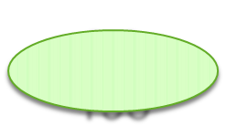
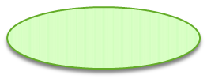
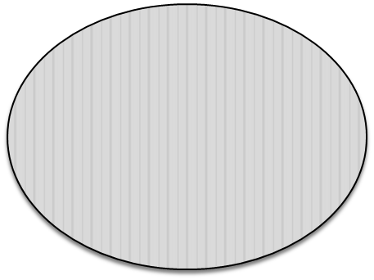
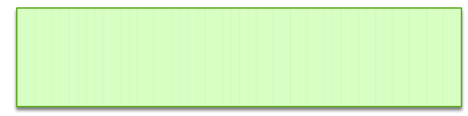
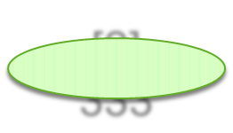

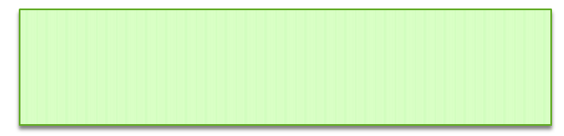
Example: distributed sorting
Idea:
Spec:
[0] 193
[1] 31
Let P(i) swap values with P(i+1).
Network
[2] 333
[3] 31
Eventually the values will be sorted.

Slide 23
SPIN model
init {
byte i ;
do
:: i<N ->
if
:: a[i]=0
:: a[i]=1
...
fi ; i++
:: else -> break ;
od ;
i=0 ;
do
:: i< N - 1 -> run P(i) ; i++
:: else -> run detect() ; break
od
}
#define N 5
byte a[N] ;
proctype P(byte i) {
byte tmp = 0 ;
do
:: d_step{ a[i]>a[i+1] ->
tmp=a[i] ;
a[i]=a[i+1] ;
a[i+1]=tmp ;
tmp=0 }
od ;
}
Swap values, set tmp back to 0 to save state.

Slide 24
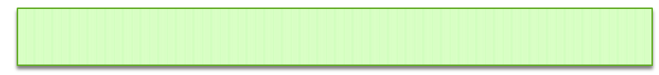
Expressing the spec
Eventually the values will be sorted.
With LTL:
<>[] (∀i : 0 ≤ i < N-1 : a[i] ≤ a[i +1])
But SPIN does not support quantification in its Expr!
Introduce a global shadow var i, non-deterministically initialized to : 0≤i<N-1. Then verify this instead :
<>[] a[i] ≤ a[i +1]

Slide 25
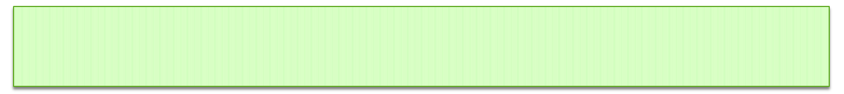
Detecting “termination”
New spec: we want each P(i) to know that the goal (to sort values) has been acomplished.
proctype detect() {
byte i ;
timeout ->
do
:: i<N-1 -> assert (a[i]<=a[i+1])
:: else -> break
od
}
done = true
Extend P(i), such that when it sees “done” is true, it will terminate.
Unfortunately, not good enough. The above solution uses “timeout” which here serves as a mechanism to detect termination; in the actual system we now assume not to have this mechanism in the first place, and hence have to implement it ourselves.

Slide 26
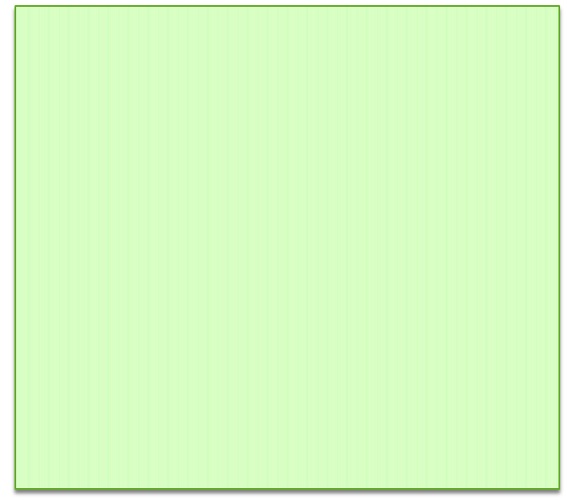
Detecting “termination”
Idea: let “detect” keep scanning the array to check if it is sorted.
Unfortunately, this doesn’t work perfectly. Consider this sequence of steps:
[ 4, 5, 1 ]
detect 0,1 → ok
swap 1,2
[ 4, 1, 5 ]
detect 1,2 → ok
now “detect” concludes termination!
Can you find a solution for this??
proctype detect() {
byte i ;
i=0 ;
do
:: i<N-1 -> if
:: a[i]>a[i+1] -> i=0
:: else -> i++
fi
:: else -> done=true ; break
od
}

